Slide 1
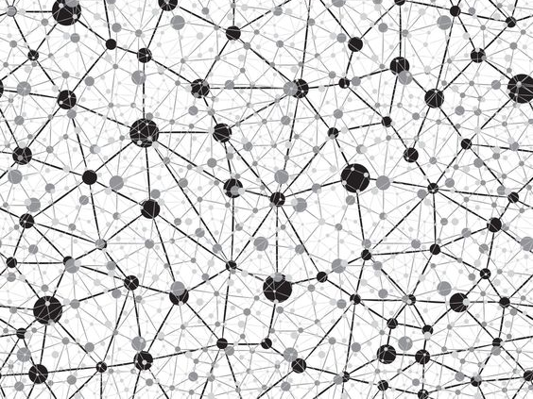
Image Super-Resolution Using Deep Convolutional Networks
GROUP H: HAO BAI,

Slide 2
OUTLINE
Background
Introduction
Experiments
Conclusion
Question

Slide 3


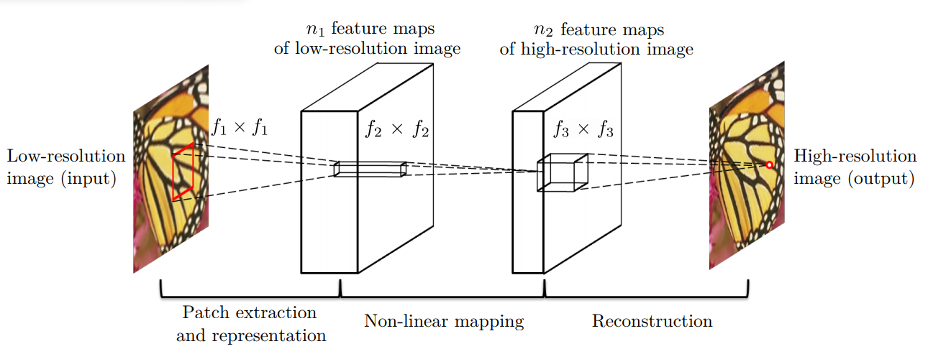
Image super-resolution (SR)
Detailly show the picture, smoothly

Slide 4
Appealing Properties
Fully obtained through learning, with little pre/postprocessing
Only pre-processing: upscale low-resolution image to the desired size(method: using bicubic interpolation)
Achieve fast speed for practical on-line usage even on a CPU(moderate numbers of filters and layers).

Slide 5
Super-Resolution Convolutional Neural Network
From "low-resolution" image to high-resolution image mapping
Patch extraction and representation.
Non-linear mapping: This operation nonlinearly maps each high-dimensional vector onto another high-dimensional vector. comprise another set of feature maps
Reconstruction: this operation aggregates the above high-resolution patch-wise representations to generate the final high-resolution image.
Training
Build low-resolution samples: Blur a sub-image by a Gaussian kernel
Loss function: Mean Squared Error(MSE)
Help to improve PSNR
It is flexible for the network to adapt to that metric(difficult to achieve for traditional “handcrafted” methods.)
Loss minimizing : stochastic gradient descent with the standard backpropagation
Avoid border effects during training: all the convolutional layers have no padding, and the network produces a smaller output

Slide 6
Experiments
Training data:
Compare
1. Small data set: 91-image dataset be decomposed into 24,800 sub-images, which are extracted from original images with a stride of 14
2. Larger data set: 395,909 images from the ILSVRC 2013 ImageNet detection training partition.
Observed: With the same number of backpropagations
1. the SRCNN+ImageNet achieves 32.52 dB
2. 91 images achieves 32.39 dB lower than lager data training
However, the effect of big data is not as impressive as that shown in high-level vision problems. Because that the 91 images have already captured sufficient variability of natural images.
Default training set: ImageNet, which contains more diverse data

Slide 7
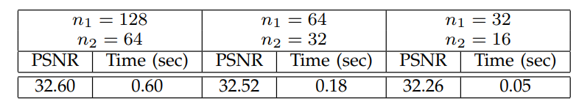
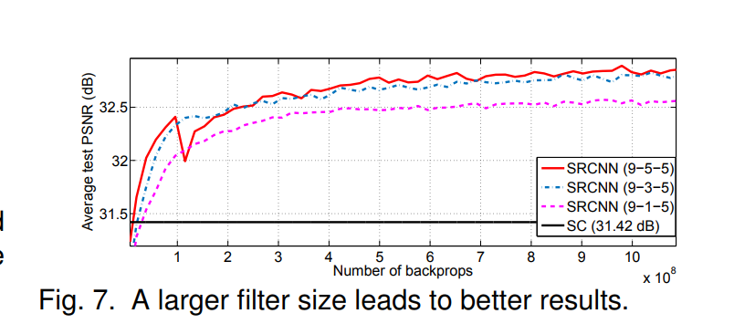
Experiments
Model and Performance Trade-offs
Filter number
1. In general, the performance would improve if we increase the network width, i.e., adding more filters, at the cost of running time
Filter size
Using a larger filter size could significantly improve the performance
The deployment speed will also decrease with a larger filter size.
Number of layers

Slide 8
Experiments
Model and Performance Trade-offs
Number of layers
The effectiveness of deeper structures for super resolution is found not as apparent as that shown in image classification
Four-layer networks converge slower than the three-layer network.
Nevertheless, given enough training time, the deeper networks will finally catch up and converge to the three-layer ones.
Deeper networks do not always result in better performance.
Comparisons to State-of-the-Arts
The hardware give the possibility to increase the layers, filters and filter size.

Slide 9
Conclusion
Conventional sparse-coding-based SR methods can be reformulated into a deep convolutional neural network.
Approach: SRCNN, learns an end-to-end mapping between low- and high-resolution images, with little extra pre/post-processing beyond the optimization

